Slide 1


Guilherme Borsari
2023 December 29th

Slide 2

Outline
Executive Summary
Introduction
Methodology
Results
Conclusion
Appendix

Slide 3
Executive Summary
Methodology:
Data collection from SPACEX API
Exploratory Data Analysis
Data cleaning and preparation
Geographical analysis with Folium
Data visualization
Machine learning prediction
Features engineering and data standardization
Training data and test data split
Hyperparameter optimization for SVM, Classification Trees, KNN and Logistic Regression
Methods evaluation using test data
Results
In the data visualization section some important relationships were found, for example:
Flight Number vs. Launch Site
Payload vs. Launch Site
Success rate of each orbit type
Success yearly trend
The machine learning algorithms were evaluated with a prediction score of:
SVM: 0.83
Classification Trees: 0.78
Logistic Regression: 0.83
KNN: 0.83

Slide 4
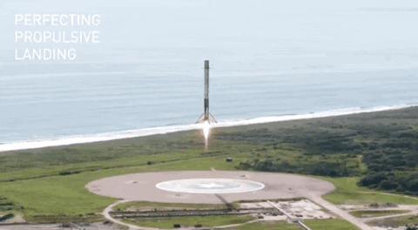
Introduction
Space X advertises Falcon 9 rocket launches on its website with a cost of 62 million dollars; other providers cost upward of 165 million dollars each, much of the savings is because Space X can reuse the first stage. Therefore if we can determine if the first stage will land, we can determine the cost of a launch. This information can be used if an alternate company wants to bid against space X for a rocket launch.
Solution: study the data looking for insights and create a machine learning pipeline to predict if the first stage will land given the data from previous launches.

Slide 5

Section 1

Slide 6
Methodology
Executive Summary
Data collection methodology:
Data was collected from Spacex API and scrapped from a Wikipedia page
Perform data wrangling
The data frame were filtered to only include Falcon 9 launches
Missing Values were dealt with
Perform exploratory data analysis (EDA) using visualization and SQL
Perform interactive visual analytics using Folium and Plotly Dash
Perform predictive analysis using classification models
Create a landing outcome label (0,1)
Features engineering and data standardization
Training data and test data split
Hyperparameter optimization for SVM, Classification Trees, KNN and Logistic Regression
Methods evaluation using test data

Slide 7
Data Collection
The data were collected either from Spacex API and Wikipedia webscrapping
Spacex API
Wikipedia Web scrapping
Falcon 9 launches data

Slide 8
GitHub URL of the completed SpaceX API calls notebook
Data Collection – SpaceX API
Spacex API
IDs
‘rocket', 'payloads', 'launchpad', 'cores', 'flight_number', 'date_utc’ IDs
Spacex API:
getBoosterVersion()
getLaunchSite()
getPayloadData()
getCoreData()
BoosterVersion, PayloadMass, Orbit, LaunchSit
Outcome, Flights, GridFins, Reused, Legs, LandingPad,
Block, ReusedCount, Serial, Longitude, Latitude
DataFrame

Slide 9
GitHub URL of the completed web scraping notebook
Data Collection - Scraping
Get(Wikipedia url)
BeautifulSoup
Find table
Find headers
Find rows
DataFrame
Flight No., Launch site, Payload, Payload mass, Orbit, Customer, Launch outcome, Version Booster, Booster landing, Date, Time

Slide 10
GitHub URL of the completed data wrangling related notebooks
Data Wrangling
Identify missing values
Identify which columns are numerical and categorical
Calculate the number of launches on each site
Calculate the number and occurrence of each orbit
Calculate the number and occurrence of mission outcome of the orbits
Create a landing outcome label from Outcome column
Bad outcome: 0
Good outcome: 1
10

Slide 11
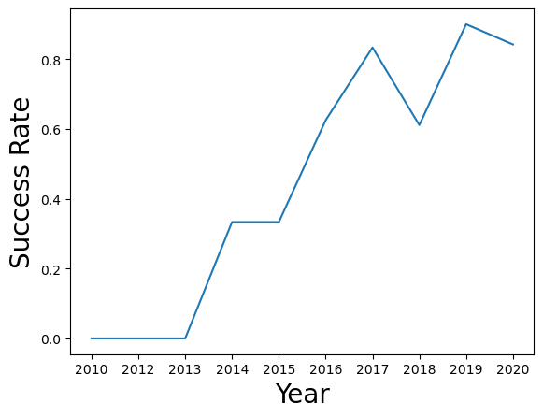
GitHub URL of the completed EDA with data visualization notebook
EDA with Data Visualization
Some charts were plotted and important relationships were found, for example:
Flight Number vs. Launch Site
Payload vs. Launch Site
Success rate of each orbit type
Flight Number and Orbit type
Payload and Orbit type
Success yearly trend →

Slide 12
GitHub URL of the completed EDA with SQL notebook
EDA with SQL
Display the names of the unique launch sites in the space mission
Display 5 records where launch sites begin with the string 'CCA’
Display the total payload mass carried by boosters launched by NASA (CRS)
Display average payload mass carried by booster version F9 v1.1
List the date when the first succesful landing outcome in ground pad was acheived.
List the names of the boosters which have success in drone ship and have payload mass greater than 4000 but less than 6000
List the total number of successful and failure mission outcomes
List the names of the booster_versions which have carried the maximum payload mass. Use a subquery
List the records which will display the month names, failure landing_outcomes in drone ship ,booster versions, launch_site for the months in year 2015.
Rank the count of landing outcomes (such as Failure (drone ship) or Success (ground pad)) between the date 2010-06-04 and 2017-03-20, in descending order.

Slide 13

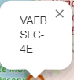
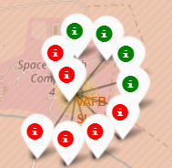
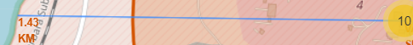
GitHub URL of your completed interactive map with Folium map
Build an Interactive Map with Folium
Map Object | Object name | Function
 | Circle | Show precise locations of the launch sites
 | Marker | Identify each circle with the launch site name. Cleaner
 | Pop Up | Identify each circle with the launch site name. More readable
 | Cluster | Useful to register different launches in a single launch site. Avoids visual mess
 | PolyLine | Identify distances.

Slide 14
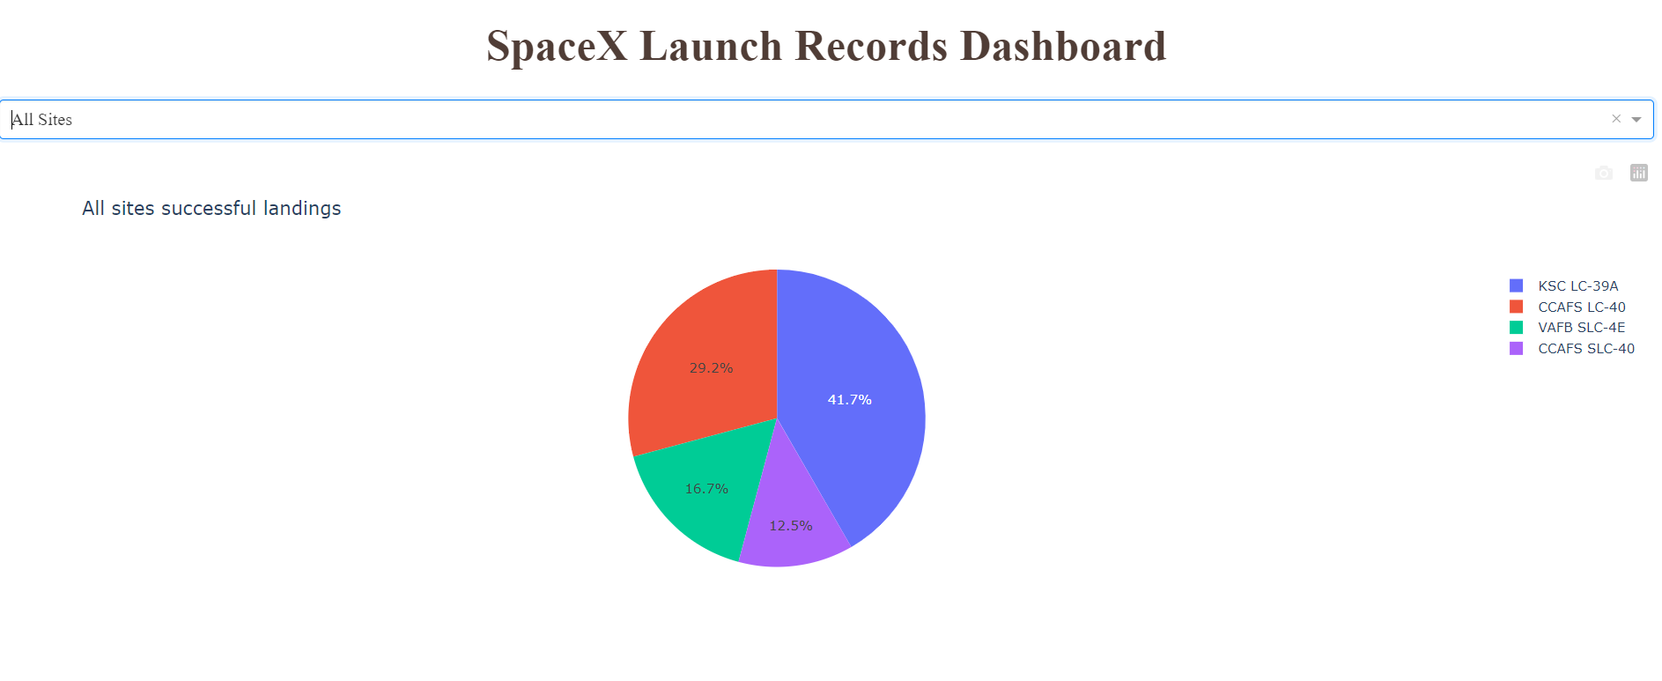
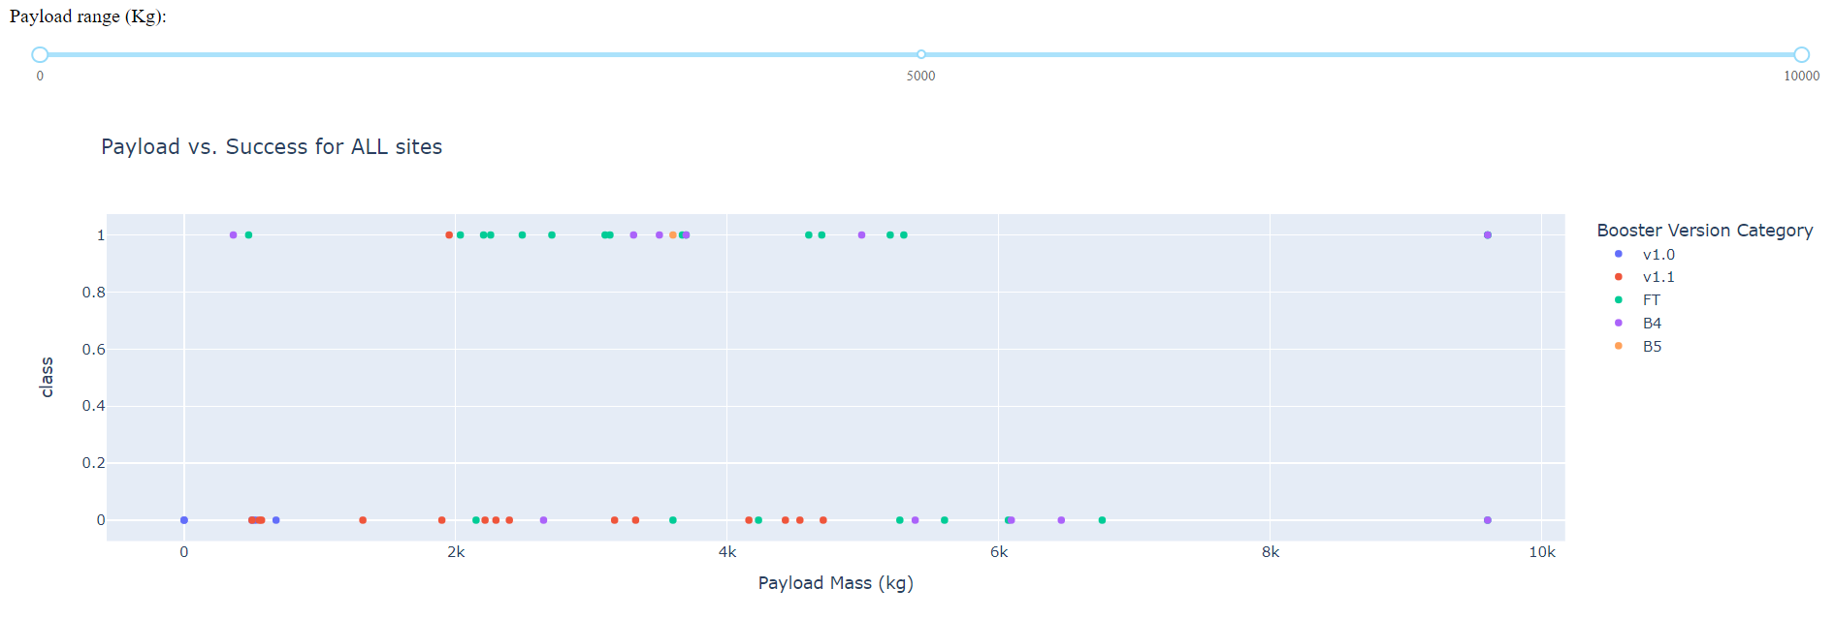
GitHub URL of the completed Plotly Dash lab
Build a Dashboard with Plotly Dash
A Pie chart was added to the dashboard, alongside a Scatter plot.
Using Callback functions, a Dropdown list and a Range slider were added in order to filter the data
The Pie chart was useful to present a visual comparation between launch sites success rates
The Scatter plot is useful to look for patterns in success factor between payload mass and booster version for each or all launch sites.

Slide 15
GitHub URL of the completed predictive analysis lab
Predictive Analysis (Classification)
Features: X
Class: Y
X → Normalized
(Standard Scaler)
Train test split
Model
(Logistic Regression, SVM, Decision Tree and KNN)
Hyperparameters
(GridSearchCV)
Evaluation:
Score, Confusion Matrix

Slide 16
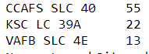
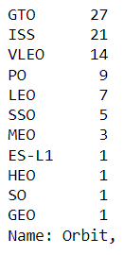
Results
Exploratory data analysis was made and some information was collected, for example:
Cape Canaveral Space Launch Complex has the biggest number of launches
Launches to Orbit Types GTO and ISS were the most expressive
GTO is valuable for monitoring weather, communications and surveillance;
ISS is a modular space station (habitable artificial satellite) in low Earth orbit.
Exploratory data analysis results
Interactive analytics demo in screenshots
Predictive analysis results

Slide 17
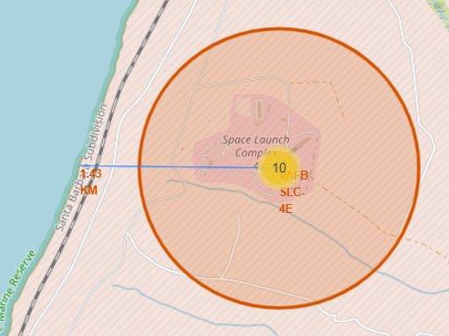
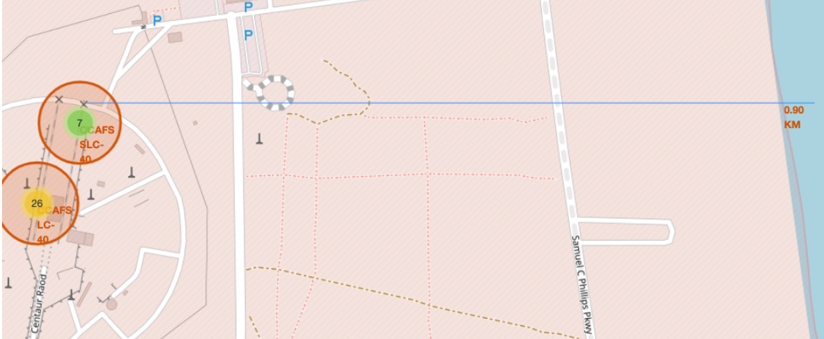
Results
Cape Canaveral Space Launch Complex is the closest to the ocean

Slide 18
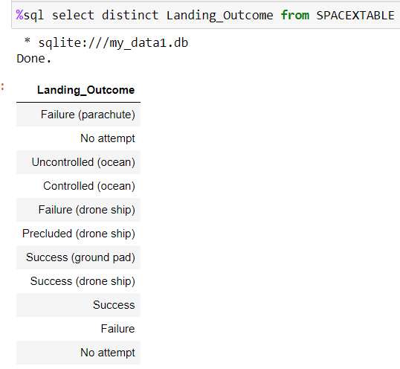
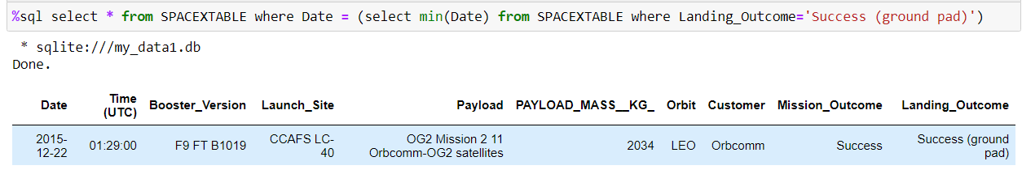
Results
There are all this Landing Outcomes
The first successful landing outcome in ground pad was achieved in 12/22/2015

Slide 19
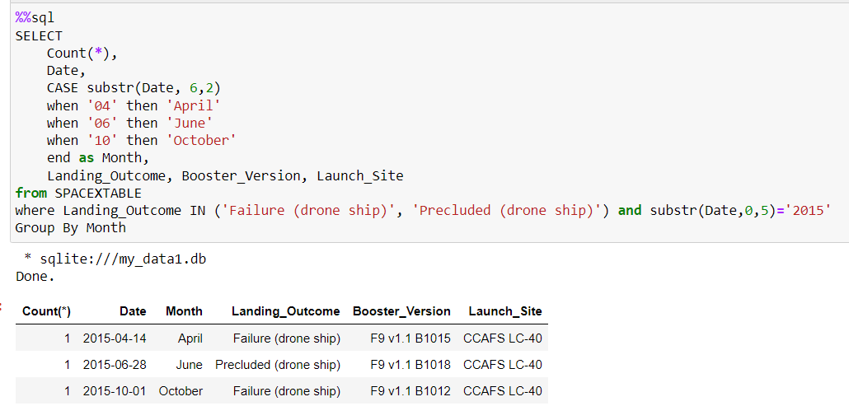
Results
In the same year (2015), they had 3 failures when trying to land in drone ships

Slide 20
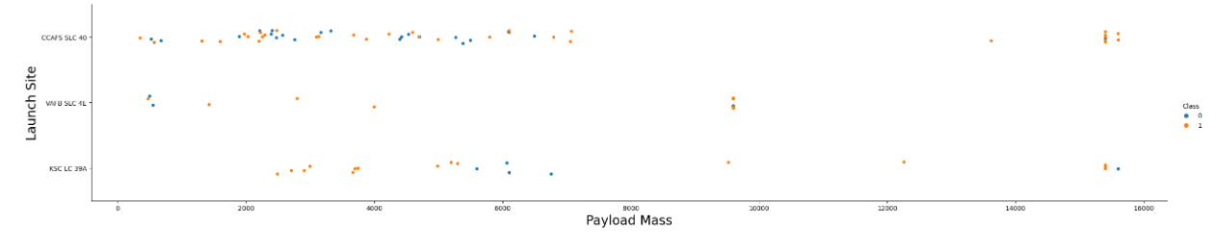
Results
In this chat, we can observe that in the CCAFS site, the success rate is greater for bigger Payload Mass
Also, in the VAFB-SLC launchsite there are no rockets launched for heavy payload mass (greater than 10000).

Slide 21

Section 2

Slide 22
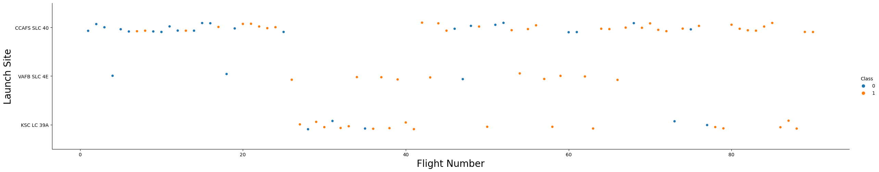
Flight Number vs. Launch Site
In the scatter plot, we can observe that most launches were first made in CCAFS site
Also, we see that the success fator has been improved along the years

Slide 23
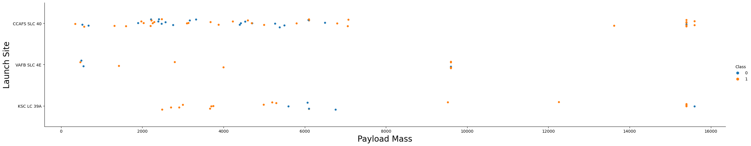
Payload vs. Launch Site
In this chat, we can observe that in the CCAFS site, the success rate is greater for bigger Payload Mass
Also, in the VAFB-SLC launch site there are no rockets launched for heavy payload mass (greater than 10000).

Slide 24
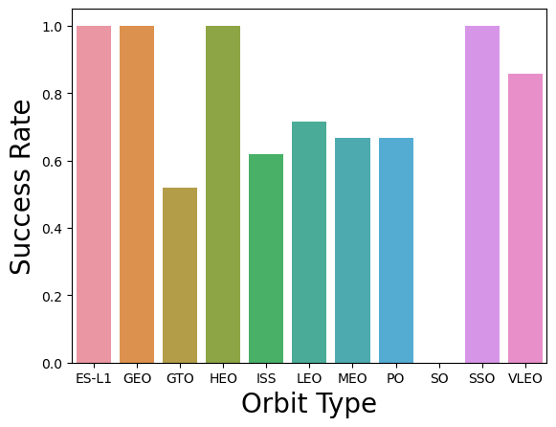
Success Rate vs. Orbit Type
Here we see that some orbit types have different success rates then others, but we must consider that too few launches have been made for some of then
Number of launches per Orbit Type

Slide 25
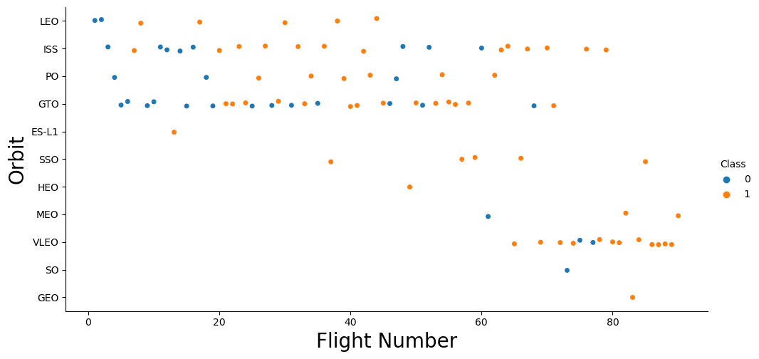
Flight Number vs. Orbit Type
In the LEO orbit the Success appears to be strong related to the number of flights; on the other hand, there seems to be a weaker relationship between flight number when in ISS, PO and GTO orbit.

Slide 26
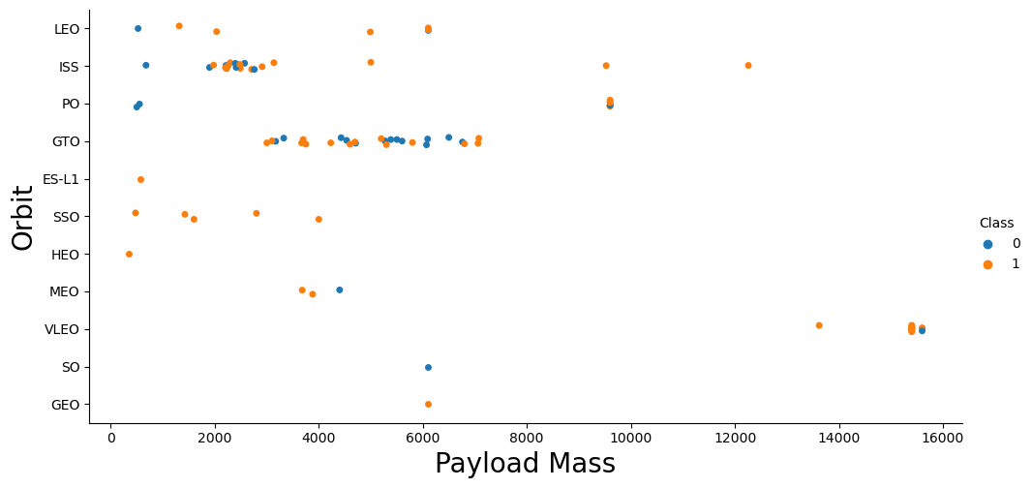
Payload vs. Orbit Type
With heavy payloads the successful landing or positive landing rate are more for Polar,LEO and ISS.
However for GTO we cannot distinguish this well as both positive landing rate and negative landing(unsuccessful mission) are both there here.

Slide 27
Launch Success Yearly Trend
We can observe that the success rate since 2013 kept increasing till 2017 (stable in 2014) and after 2015 it started increasing.

Slide 28
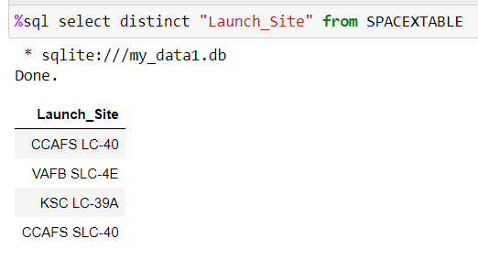
All Launch Site Names
We have four different launch sites:

Slide 29
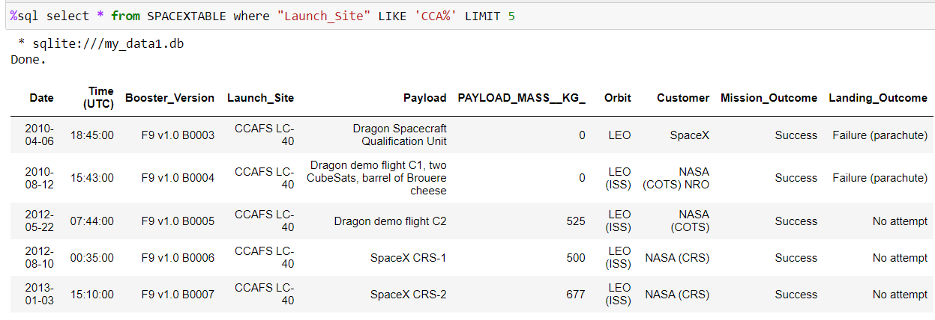
Launch Site Names Begin with 'CCA'
Here we used a filter(where) to show 5 records(limit 5) that begin with ‘CCA’(like ‘CCA%’)

Slide 30
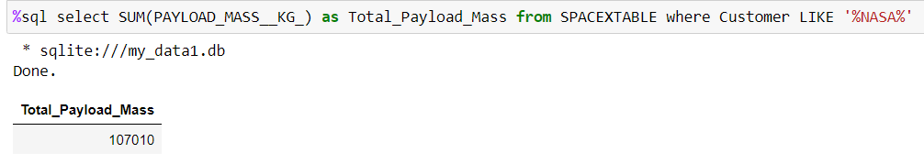
Total Payload Mass
Here we use a function (sum) alongside a filter to calculate total payload carried by boosters from NASA

Slide 31
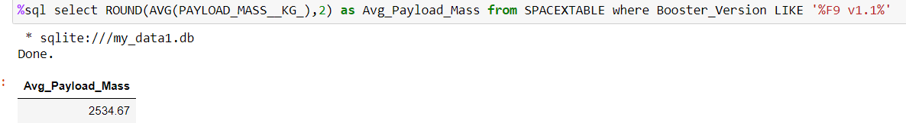
Average Payload Mass by F9 v1.1
Here we used other function (average) and another filter to find the average payload mass carried by booster version F9 v1.1

Slide 32
First Successful Ground Landing Date
The first successful landing outcome in ground pad was achieved in 12/22/2015

Slide 33
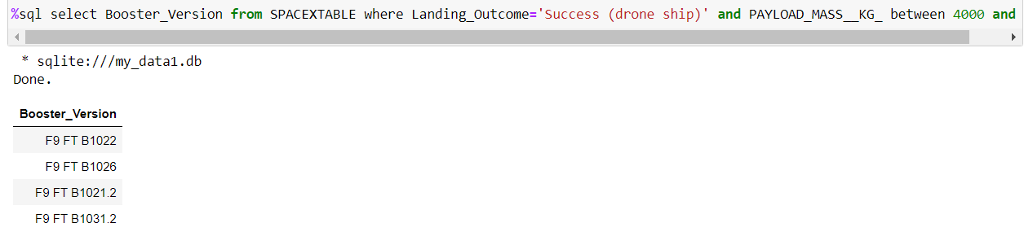
Successful Drone Ship Landing with Payload between 4000 and 6000
Here we combined three filter to select the names of boosters which have successfully landed on drone ship and had payload mass greater than 4000 but less than 6000

Slide 34
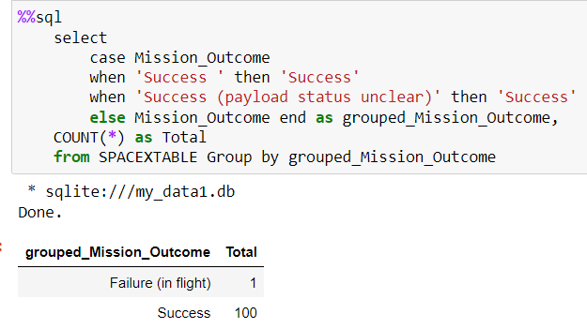
Total Number of Successful and Failure Mission Outcomes
Here we used the function Count to calculate the total number of successful and failure mission outcomes

Slide 35
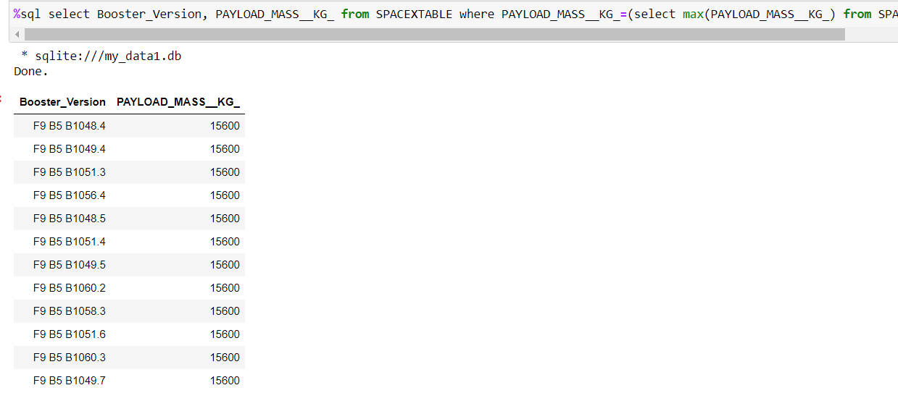
Boosters Carried Maximum Payload
Here are the booster which have carried the maximum payload mass. They all carried the same mass, which is the maximum value here

Slide 36
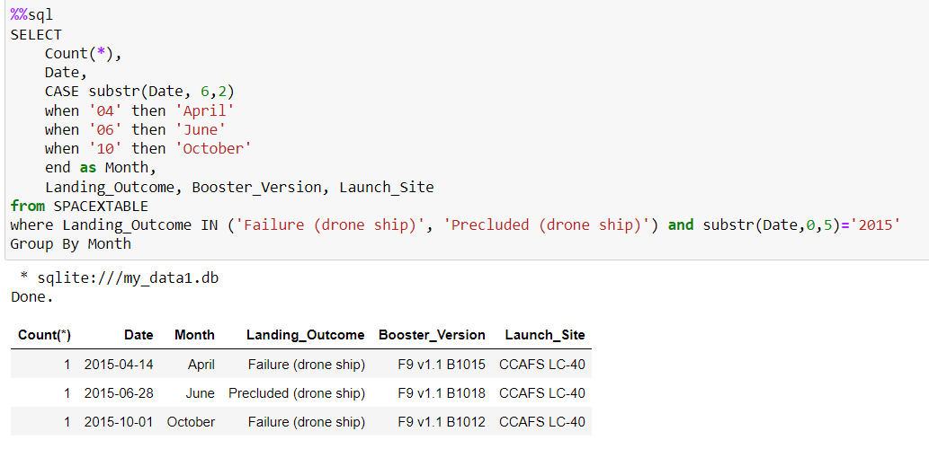
2015 Launch Records
Here we listed the failed landing outcomes in drone ship, their booster versions, and launch site names in 2015

Slide 37
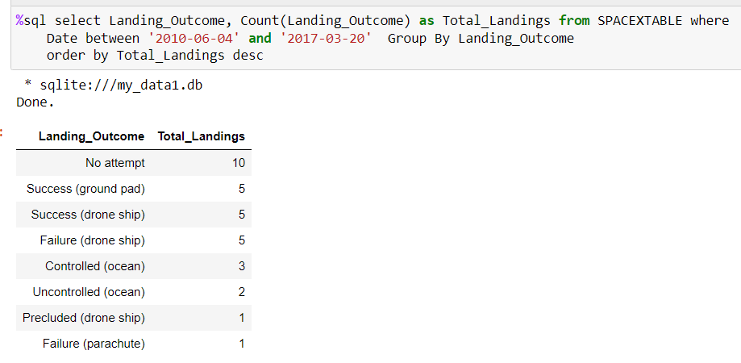
Rank Landing Outcomes Between 2010-06-04 and 2017-03-20
Here is ranked the count of landing outcomes (such as Failure (drone ship) or Success (ground pad)) between the date 2010-06-04 and 2017-03-20, in descending order

Slide 38

Section 3

Slide 39
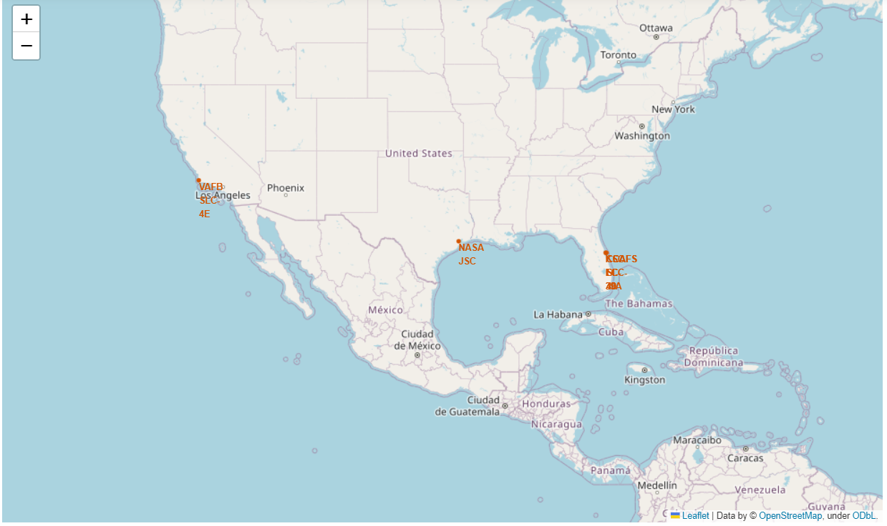
Launch Sites Location
Here we can observe that all sites are located next to the coast and in the south of USA.

Slide 40
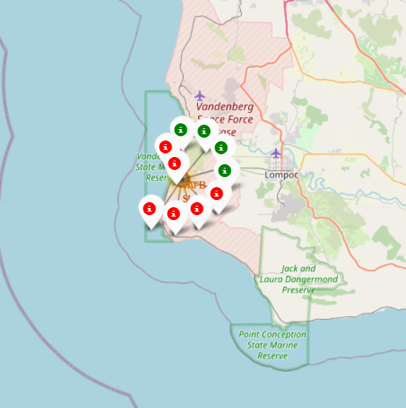
Launch Outcomes
Here we see the color-labeled launch outcomes on the map.
Due to their close proximity, we used a cluster to avoid visual mess

Slide 41
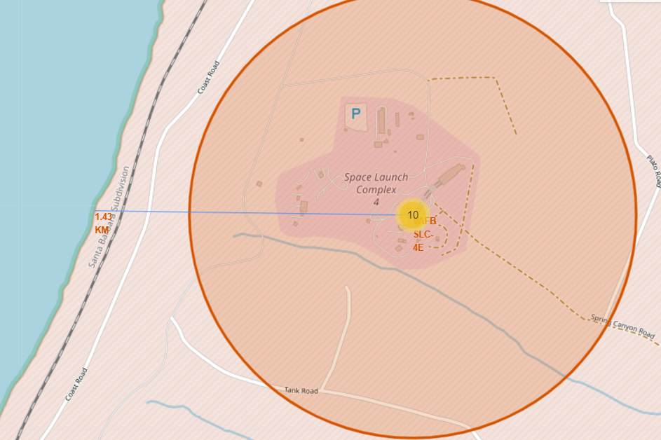
Launch site distances
Here we see that the VAFB SLC-4E site is about 1.43Km away from the coastline.

Slide 42

Section 4

Slide 43
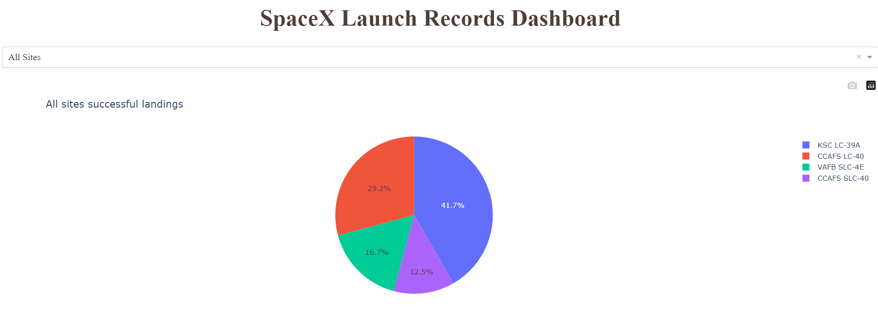
Launches success contribution
launches
In this pie chart we can see which launch site has the most contribution on launches success, and which has the least.
KSC LC-39A site has successfully launched 41.7% of all successful launches.

Slide 44
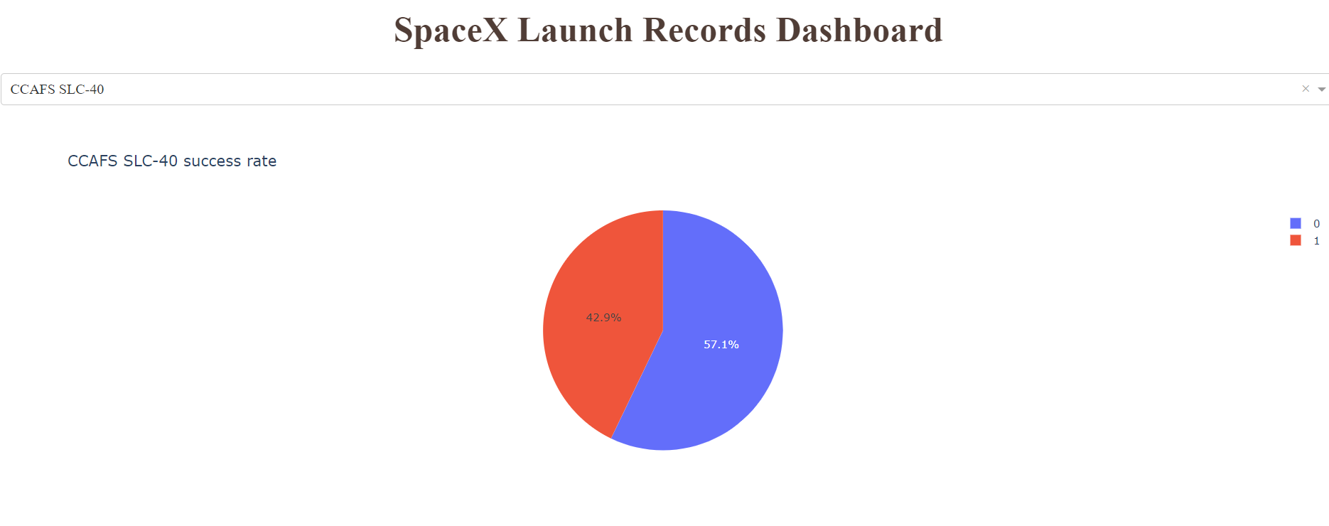
Success Rate
Here we see CCAFS SLC-40 success rate of 42.9%.

Slide 45
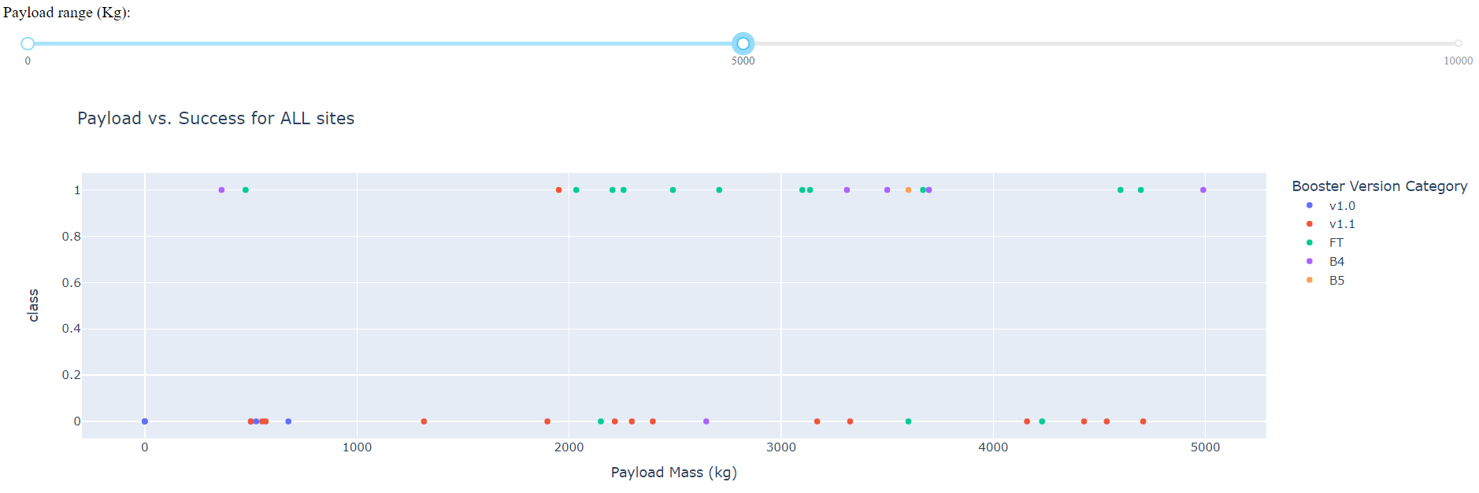
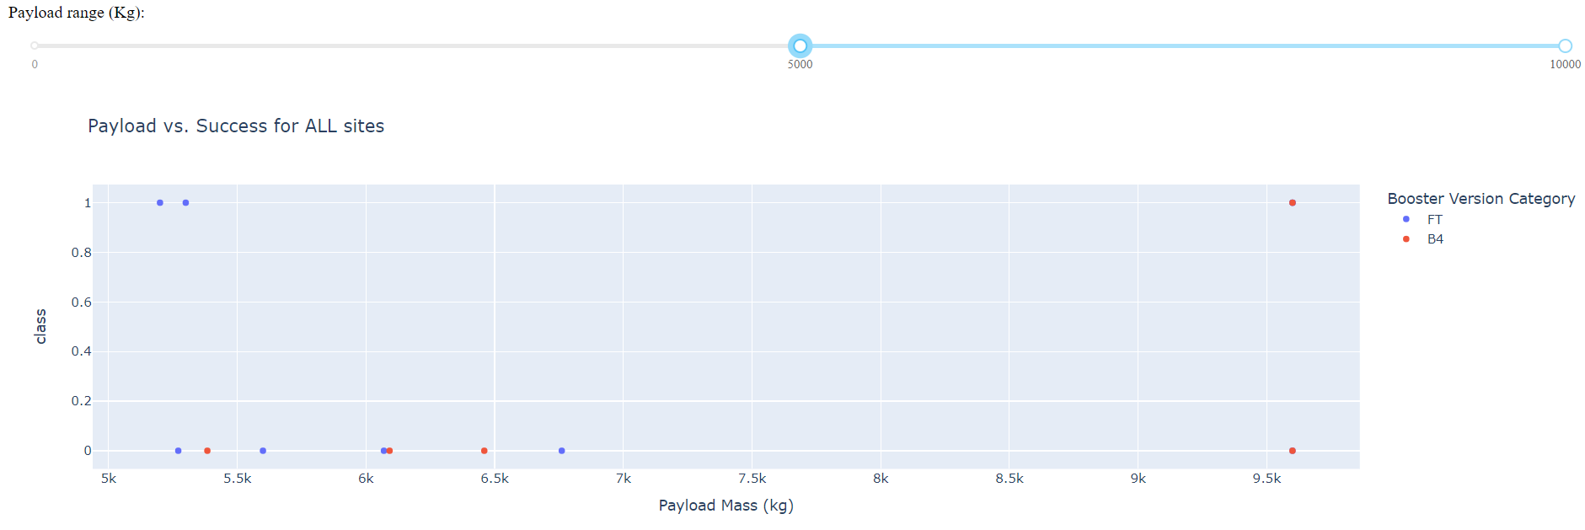
Success Rate vs. Payload Range
Comparing these two plots, we can observe that the success rate is greater when in 0-5000Kg payload mass range
Also, the FT booster version has an expressive contribution on that, unlike the other payload range, where it is not even used.

Slide 46

Section 5

Slide 47
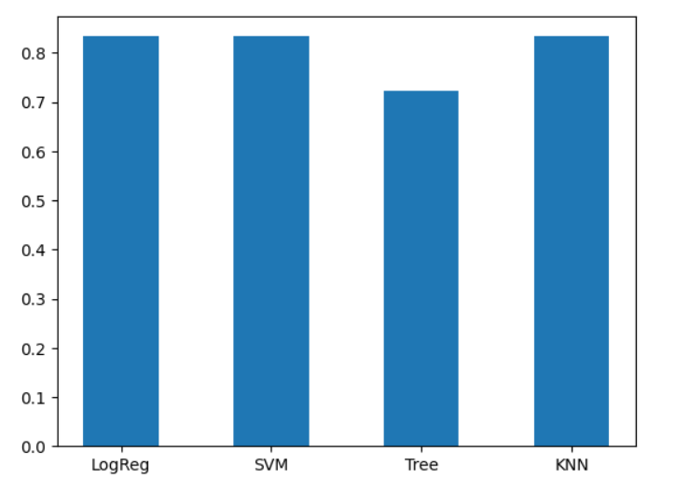
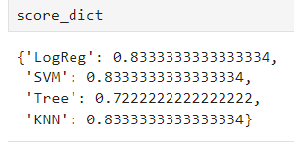
Classification Accuracy
All models achieved the same 83% accuracy, except the Decision Tree Classifier, with an accuracy of 72%.

Slide 48
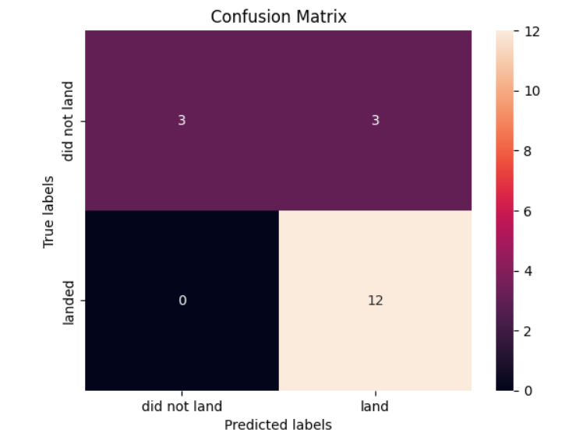
Confusion Matrix
The Confusion Matrix describes what kind of errors the model has made.
Here the model wrongly predicted 3 outcomes out of 18, it said it would land when in fact it did not.

Slide 49
Conclusions
The landing success factor has been improved along the years
Cape Canaveral Space Launch Complex has the worst success factor, but it can be explained by the early attempts
The machine learning modeling achieved a good prediction accuracy of 83%

Slide 50

github.com/borsariguilherme

